Slide 1
Knuckles, The Robotic Arm
Andrew Blanchard, Matthew van Zuilekom, Rym Benchaabane, Paola Hernandez
Sponsored by MakerSpace
ECE 4335: ECE Systems Design
Faculty Advisor: Dr. Becker

Slide 2
Overall Project
What is Knuckles?
Assistive robotic arm that will hand the user requested objects and tools
Purpose
Increase the user’s productivity
Decrease the risk of dexterity incidents
Notes:
Knuckles: Assistive robotic arm that will hand the user requested objects and tools
Purpose: Assistant that will increase the user’s productivity and decrease the risk of dexterity incidents

Slide 3
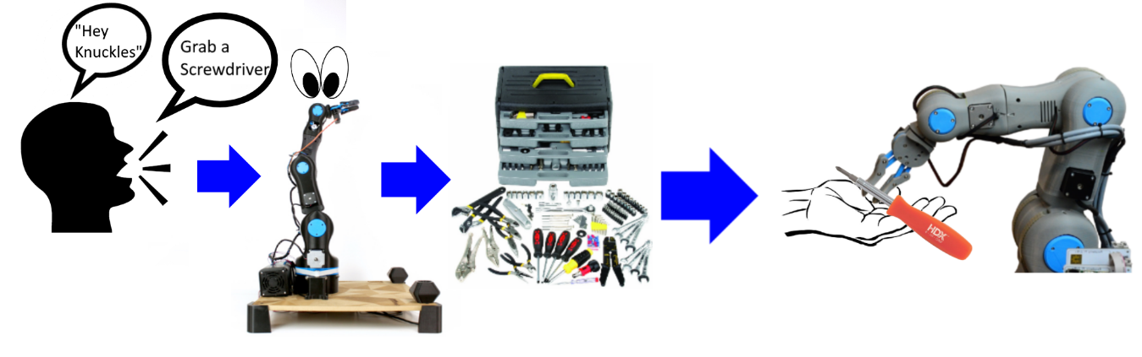
Overview Diagram
Notes:
Round corners

Slide 4
Deliverables
Fall 2018:
Physical arm and gripper prototype build [by next week]
Hardware (Intel RealSense camera, multidirectional mic, tactile pads)
Simulation using Rviz on ROS
Text commands
Object recognition (75% done)
Manual control of arm and gripper
Spring 2019 [ Mid-March ]
Complete software and automation
Voice commands
Object recognition
Fully built robot:
Tuned gripper and arm
For a fully functional robot!
Notes:
Replace image with reflection image

Slide 5
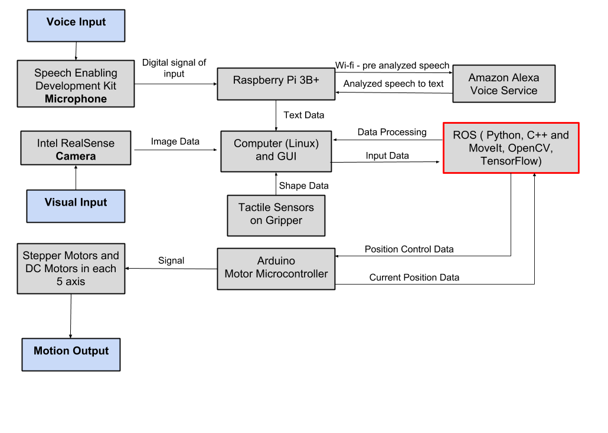
Design Considerations

Slide 6
Design Constraints
Time
Less time to optimize the gripper design to accommodate more shapes
Limited vision field
RealSense depth camera can’t see within one foot
Lift Weight limitation

Slide 7
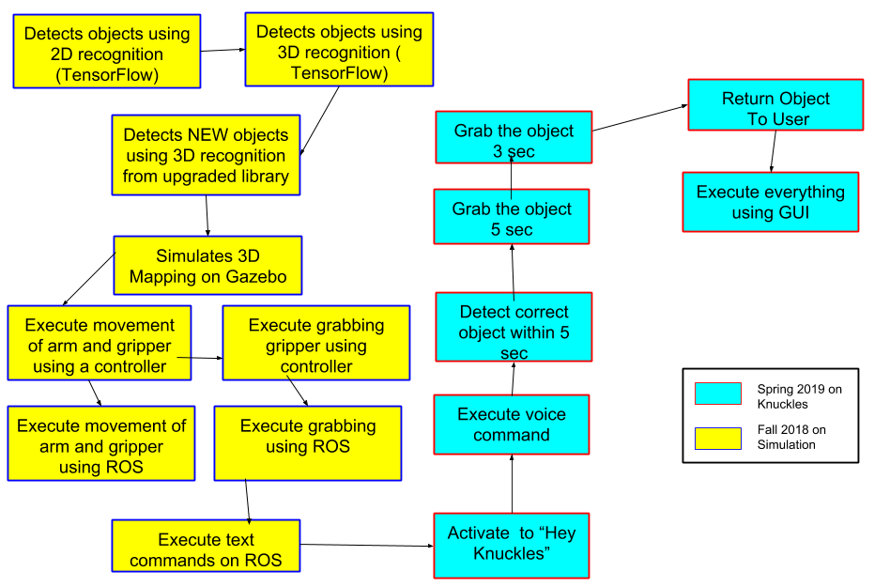
Target Objective - Goal Analysis

Slide 8
Test Plan & Schedule
November:
Robot is assembled and controlled with a controller
Maker Showcase ( Nov 9th )
Test the mobility of the robot: Verify the arm and gripper motion with a controller and when connected to ROS.
December:
Test the search function: Use text recognition to have the robot point at objects.
Test the retrieval function: Use text recognition to retrieve an object
Notes:
List test plan

Slide 9
Test Plan & Schedule
January:
Test the voice recognition: Compare voice commands to the text in the ROS terminal.
Test the gripper with the return: Robot presents user with object and waits until the user pulls on the object to let go.
February:
Last minute tuning
March:
2019 ECEDHA Conference in Tucson, Arizona
Notes:
Replace image with reflection image

Slide 10
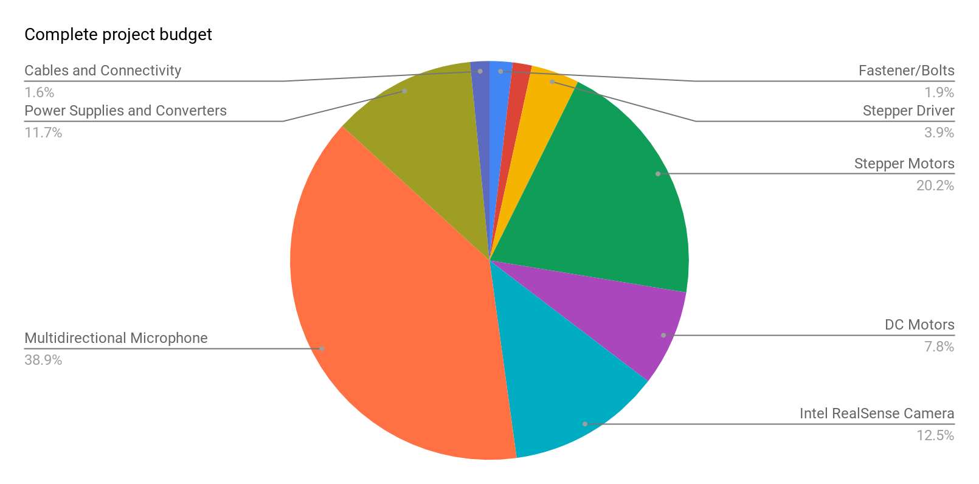
Budget
Total Budget : 1,800 $
Used 60%
Notes:
Round corners

Slide 11
Project Conclusion
Schedule
Fall semester: most of the simulation and manual control
Spring Semester: implementation of software on Knuckles
Test plan
Modular plan will help us accomplish our goals
Current progress
Done 3D Printing parts
Used 60% of budget
We are on track!
Notes:
By the end of the Fall semester, the physical robot arm will be constructed, and we can use a simulation in Rviz to control the robot through text commands. By the end of the Spring semester, the object detection and voice recognition of the project will be completed, and the user will be able to give voice commands to request objects from Knuckles. We will accomplish our Target Objective by following a modular test plan, allowing us to develop the hardware and software in tandem. We have ordered all the necessary components to build the robot arm, and will pick up the remaining fasteners from Home Depot. Through the IEEE Makerspace and the Robotics Lab, we have almost completed printing out the parts of the robot arm and prototype gripper. We are on track to complete our project by the end of the Spring semester.

Slide 12
Thank you for your attention
QUESTIONS?

